Slide 1
COLLEGE OF ENGINEERING TRIVANDRUM - 695016 PARENTS TEACHERS ASSOCIATION ANNUAL GENERAL BODY MEETING 2020 - 2021
Notes:
‹#›

Slide 2
FAREWELL…
Notes:
‹#›

Slide 3
DEPT. OF CIVIL ENGINEERING
Notes:
‹#›

Slide 4
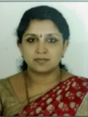
Dr. MINI SOMAN
(HOD - Dept. of Civil Engineering)
Notes:
‹#›

Slide 5
Dr. MINI SOMAN
(HOD - Dept. of Civil Engineering)
Got 31 years of service with Teaching, Research and Administration.
Worked at GEC Thrissur (10 years) and CET (21 years)
Worked as Junior Engineer at National Airports Authority for one year
Daughters - M. Gayathri (Deputy Commissioner of Income Tax, and Dr. Nandini Mohan lal (MBBS)
Retired from service on 31/05/2021
Notes:
‹#›

Slide 6
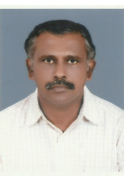
Dr. JAIRAJ P G
(Professor in Civil Engineering)
Notes:
‹#›

Slide 7
Dr. JAIRAJ P G
(Professor in Civil Engineering)
Joined in CET on 1990
31 years of service with Teaching , Research and Administration
Well known to CET as CCE Manager
Wife (Rajasree L) is a teacher
Children – Parvathy Jairaj, Keerthana R and Indu Jairaj
Retired on 2021
Notes:
‹#›

Slide 8
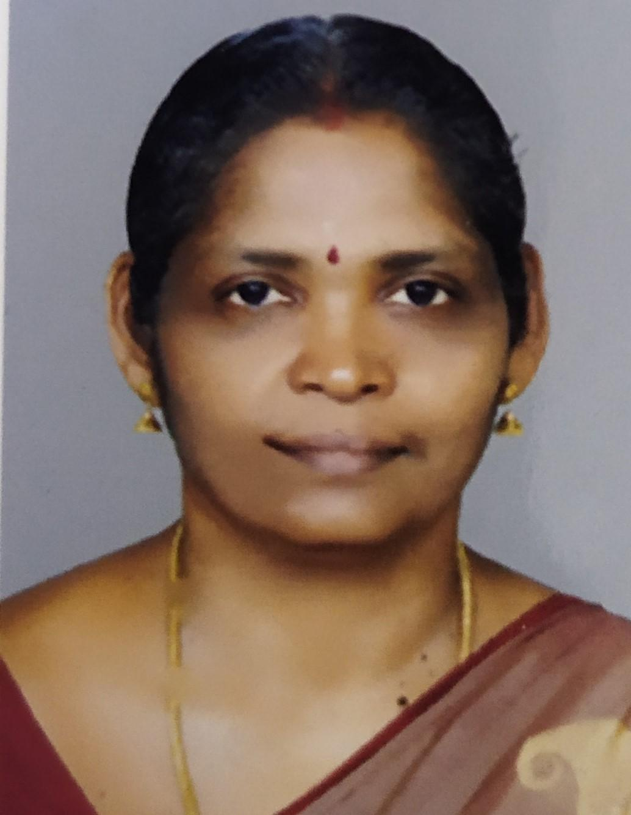
Dr. SINDHU G
DEAN- RESEARCH
(Professor in Civil Engineering )
Notes:
‹#›

Slide 9
Dr. SINDHU G
DEAN- RESEARCH
(Professor in Civil Engineering )
Joined in CET on 30/10/1989
Got 32 years of service with Teaching, Research and Administration
Husband – Dr. P Raghavan is Joint Registrar (Retd) - University of Kerala.
Son – Rahul Raghavan is an alumnus of CET
Retired on 30/04/2021
Notes:
‹#›

Slide 10
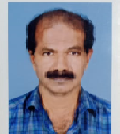
PROF. JAYPRAKASH JAIN KG
(Professor in Civil Engineering )
Notes:
‹#›

Slide 11
PROF. JAYPRAKASH JAIN KG
(Professor in Civil Engineering )
Joined in CET on Jan 1991
Also worked at RIT Kottayam
Got 31 years of service with Teaching , Research and Administration
Father– Sri. G. Gopalan
Mother – K Omana
Native - Kollam
Notes:
‹#›

Slide 12
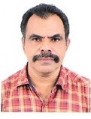
Prof. B THULASEEDHARAN NAIR
(Professor in Civil Engineering)
Notes:
‹#›

Slide 13
PROF. B THULASEEDHARAN NAIR
(Professor in Civil Engineering)
J
Joined in CET on 3/10/1991
Got 30 years of Teaching, Research and Administration
Well known as the Waterman of CET, Contributed well for the water management system of CET with a good vision
Wife – Asha Pillai A, Assistant Superintendent of Post office
Son -Athul T Narayanan
Native place – Kulakada, Kottarakkara
Retired on 31/05/2021
Notes:
‹#›

Slide 14
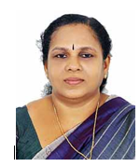
Dr. PRABHAKUMARI K. S
(Dept. of Civil Engineering)
Notes:
‹#›

Slide 15
Dr. PRABHAKUMARI K. S
(Dept. of Civil Engineering)
Joined CET on 2002
Worked at GEC Barton hill also
18 years of service with Teaching, Research and Administration .
Husband - L .Vijayakumar.
Daughters - Er. Jayalekshmi and Dr. Jaya Priya
Retired on 31/03/2021
Notes:
‹#›

Slide 16
DEPT. ELECTRONICS AND COMMUNICATION ENGINEERING
Notes:
‹#›

Slide 17
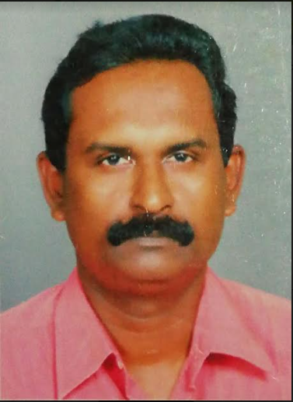
PROF. JAYAKRISHNARAJ G
Professor and Head
Dept. of Electronics and Communication Engineering
Notes:
‹#›

Slide 18
PROF. JAYAKRISHNARAJ G
Professor and Head
Dept. of Electronics and Communication Engineering
Joined CET on 1990, Worked at GEC idukki and Kannur also
30 Years of service with Teaching , Research and Administration
Coordinated CET Campus Beautification activities
Wife - C T Bindhu I R S (Asst.commissioner of central Excise and Customs)
Son - Ashwin J Raj
Daughter - Devi Priya J Raj
Retired on 31/05/2021
Notes:
‹#›

Slide 19
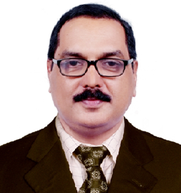
PROF. AMBY A. K
(Professor in Electronics and Communication Engineering)
Notes:
‹#›

Slide 20
PROF. AMBY A. K
(Professor in Electronics and Communication Engineering)
One year industrial experience as Electronic Engineer
Worked at IHRD institutions, GEC Wayanad, GEC Barton hill, GEC Idukki and CET
Got 31 years of service with Teaching Research and Administration
Wife -Sindhu T P
Daughters - Amrita Kiran and Aparna Kiran
Retired on 31/03/2021
Notes:
‹#›

Slide 21
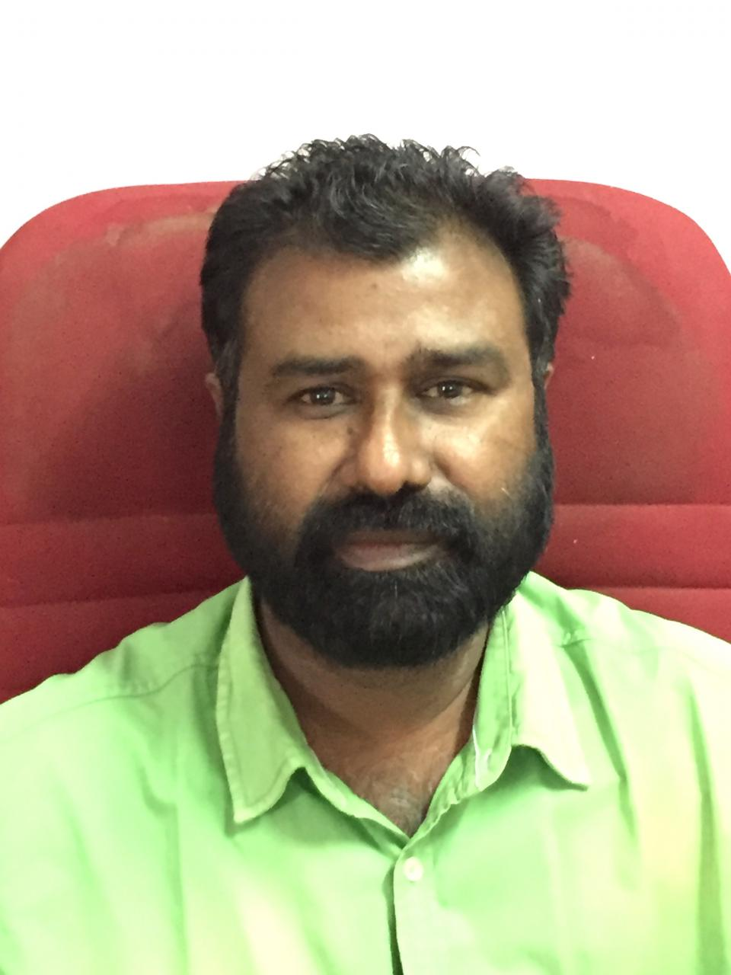
Prof. Sasikumar V.V
(Professor in Electronics and Communication Engineering)
Notes:
‹#›

Slide 22
Prof. Sasikumar V.V
(Professor in Electronics and Communication Engineering)
More than 30 Years of service with Teaching , Research and Administration
A good organizer and consultant of service matters
Retired on 31/05/2021

Slide 23
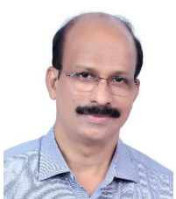
Dr. JAMES T.G
(Professor in Electronics and Communication Engineering)
Notes:
‹#›

Slide 24
Dr. JAMES T.G
(Professor in Electronics and Communication Engineering)
Joined in CET as Workshop Instructor In 1989)
Became Lecturer in Electronics in 2001
32 Years of service with Teaching, Research and Administration
Also worked in Abdul KalamTechnological University
Coordinated Pulse Oximeter Research and Development
Wife - Manju Susan Cherian (Asst. Executive Engineer,KSEB)
Son - Jerrin George James
Daughter - Merrin Sairah James(student)
Retired on 31/05/2021
Notes:
‹#›

Slide 25
DEPT. OF MECHANICAL ENGINEERING
Notes:
‹#›

Slide 26
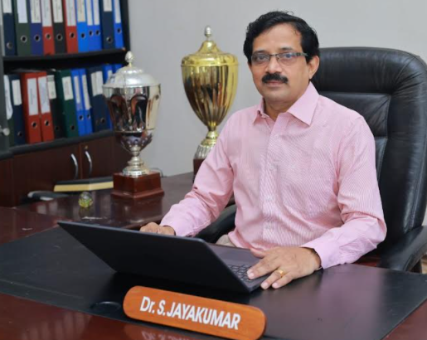
Dr. S JAYAKUMAR
PG DEAN
(Professor in Mechanical Engineering)
Notes:
‹#›

Slide 27
Dr. S JAYAKUMAR
PG DEAN
(Professor in Mechanical Engineering)
31 years of service with Teaching , Research and Administration
Worked at RIT Kottayam, GEC Thrissur, GEC Bartonhill , GEC Idukki and and CET
Also worked at DTE as SPFU- Director
Coordinated activities to start new Engineering Institutions
Served as Principal at Kidangoor Engineering College
Successfully co ordinated PG online admission programs
Wife , Usha is working as Asst. General Manager-BSNL
Daughters are Dr. Parvathy J and Nandana (MBBS student)
Notes:
‹#›

Slide 28
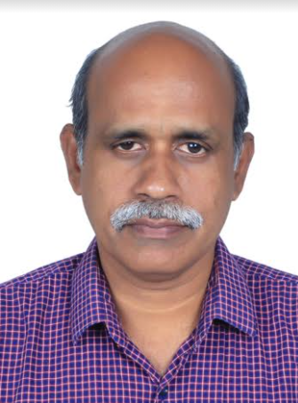
Dr. ANIL LAL S
HOD
Dept. of Mechanical Engineering
Notes:
‹#›

Slide 29
Dr. ANIL LAL S
HOD
Dept. of Mechanical Engineering
Joined in CET on 1994
Worked at GEC Kannur and GEC Barton Hill
Got four years of experience at IGCAR,Kalpakkam
31 years of service with Teaching, Research and Administration.
Author of Text books in Engineering Mathematics
An excellent researcher in Computational Fluid Dynamics
Wife - Chief Engineer in KWA
Son - Graduate from IIT Madras
Retired on 31/05/2021
Notes:
‹#›

Slide 30
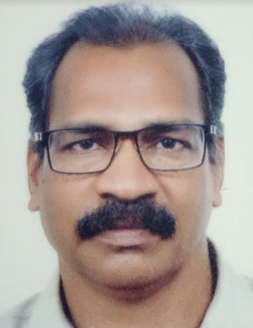
PROF. SUMESH V
(Professor in Mechanical Engineering)
Notes:
‹#›

Slide 31
Prof. SUMESH V
(Professor in Mechanical Engineering)
Joined CET in 02/07/2003
10 Year so Industry experience
18 Years of Teaching , Research and Administration
Co ordained CET safety protocols
Contributed services as Bus Secratary to CET
Wife - Bala Divya
Son- Varun S(Student)
Retired on 31/03/2021
Notes:
‹#›

Slide 32
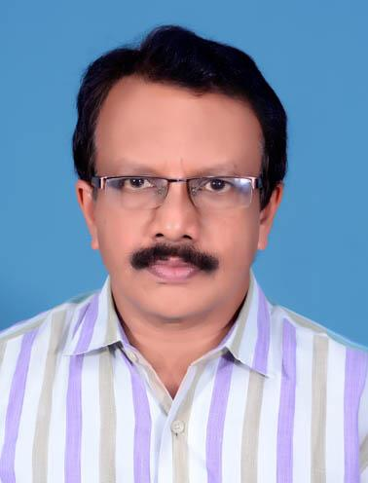
PROF. A. FAROOK
(Professor in Mechanical Engineering)
Notes:
‹#›

Slide 33
Prof. A. FAROOK
(Professor in Mechanical Engineering)
Joined CET in 1991
Three Year Industry experience at Neyveli Lignite Corporation Ltd
31 Years of Teaching , Research and Administration
Worked at GEC Thrissur and CET
Co ordained IPR Cell in CET
Served as Director -Vocational Higher Secondary Education
Served as Jt. Director LBS Centre of Science and Technology
Wife is Engineer , KSEB, children are studying
Notes:
‹#›

Slide 34
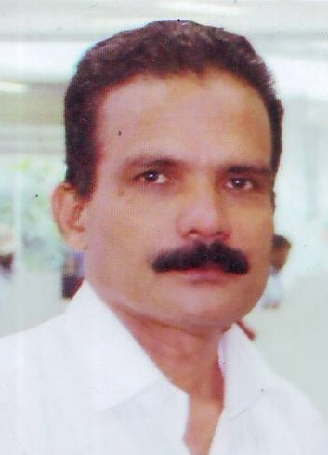
Dr. N ASOK KUMAR
( Professor in Mechanical Engineering)
Notes:
‹#›

Slide 35
Dr. N ASOK KUMAR
( Dept. of Mechanical Engineering)
31 years of service with Teaching , Research and Administration as Professor, Principal in charge, Warden etc
Worked at CET, GEC Kannur, GEC Idukki
An allrounder in CET as coordinator of many Technical events,
Founder Co ordinators of BoschRexroth, Centre of Excellence in Automation Technologies, ISTE students chapter, CET Innovation Centre and Centre for RAC system maintenance
An Excellent councilor, singer and musician
Wife is a home maker
Children are studying
Notes:
‹#›

Slide 36
DEPT. OF ELECTRICAL ENGINEERING
Notes:
‹#›

Slide 37
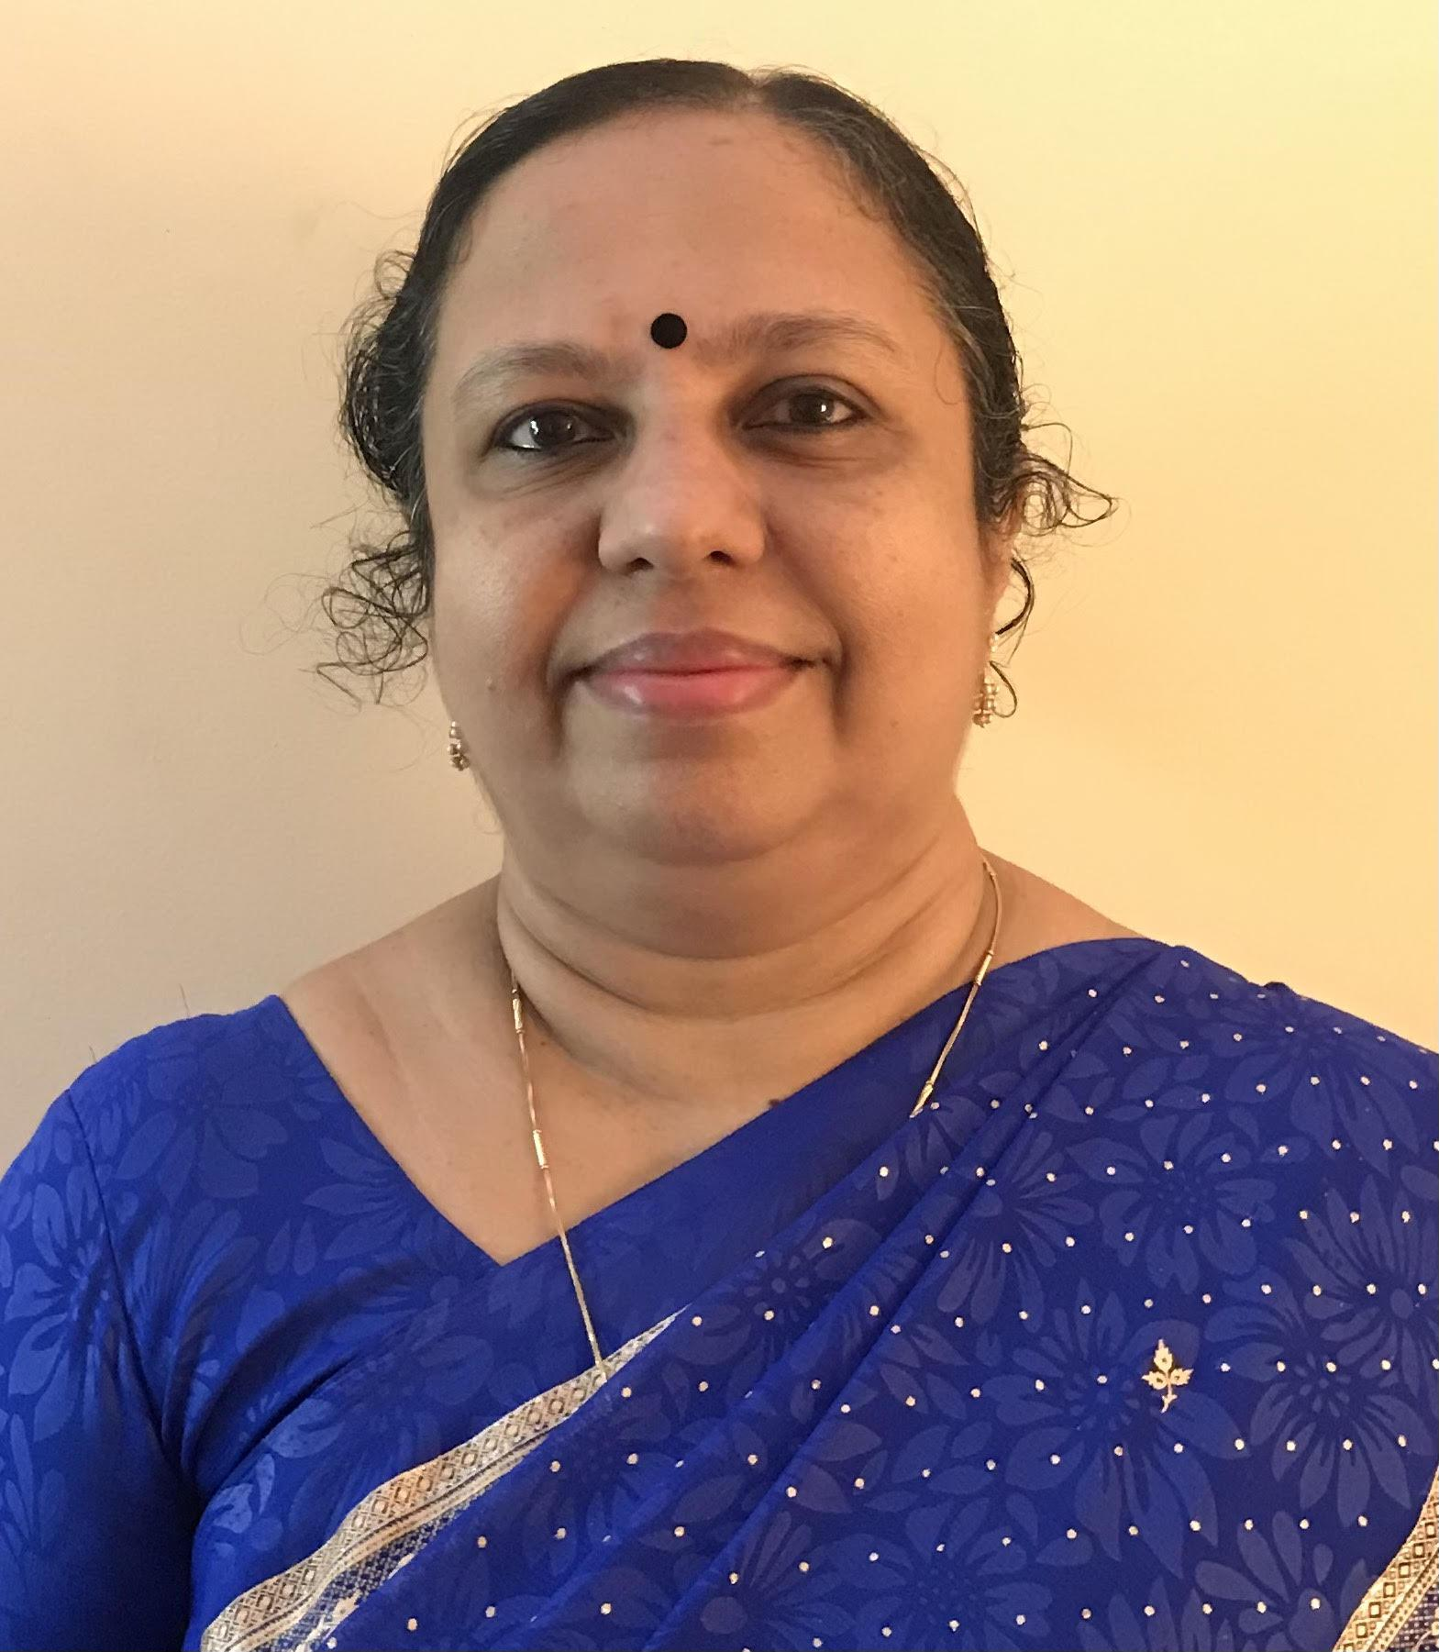
Dr. SREEJAYA P
HOD
Dept. of Electrical Engineering
Notes:
‹#›

Slide 38
Dr. SREEJAYA P
HOD
Dept. of Electrical Engineering
Joined in CET on 1990
Worked at RIT, Kottayam, and GCE Kannur
Got 31 Years of service with Teaching Research and Administration
Husband -Harikumar PK is a Mechanical Engineer
Daughter - Parvathy is doing Ph.D in IGCAR
Son - Aravind is a Mechanical Engineer.
Retired from service on 31/05/2021.
Notes:
‹#›

Slide 39
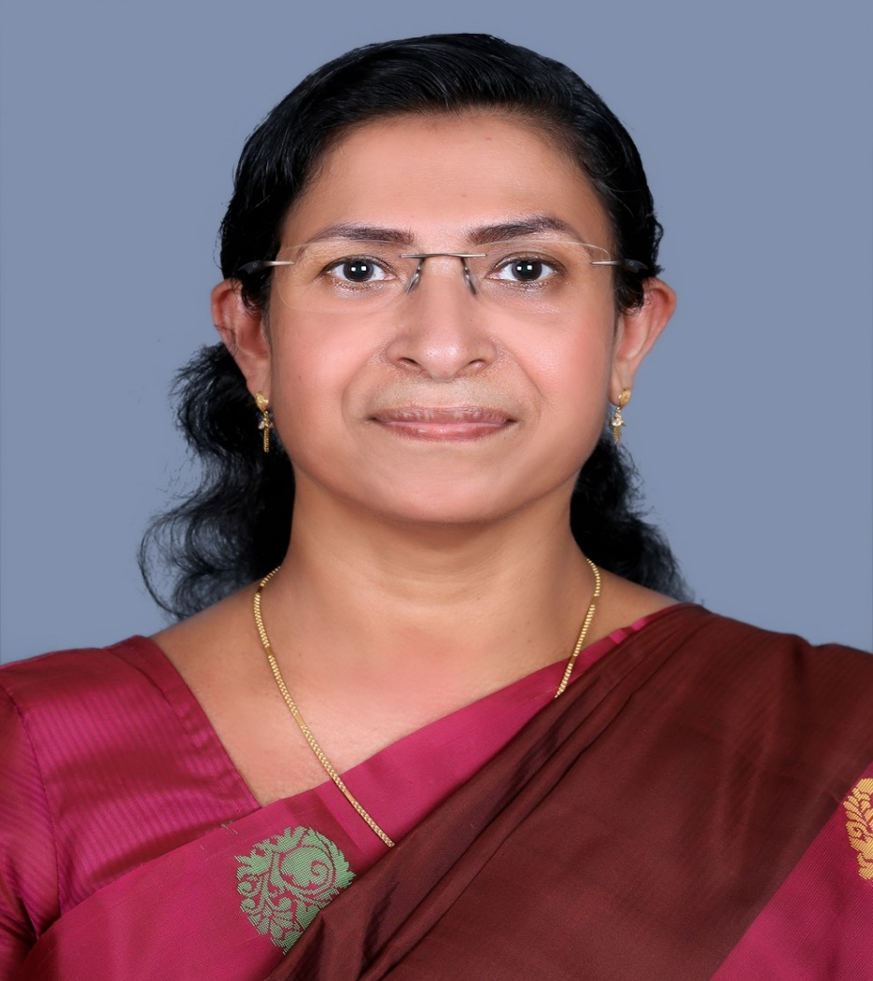
Dr.WAHEEDA BEEVI M
(Professor in Electrical Engineering)
Notes:
‹#›

Slide 40
Dr.WAHEEDA BEEVI M
(Professor in Electrical Engineering)
Joined at CET on 20/01/1990
More than 31 years of service with Teaching, Research and Administration
Served as HOD at Government Engineering college Idukki
Chief coordinator of IQAC - CET.
Chairman Anti-Ragging Squad CET
Husband - Dr. A Noushad
Children – Two daughters (Elder one is an MBBS Doctor, Younger daughter currently in third year MBBS)
Retired from service on 31/05/2021
Notes:
‹#›

Slide 41
DEPARTMENT OF ARCHITECTURE
Notes:
‹#›

Slide 42
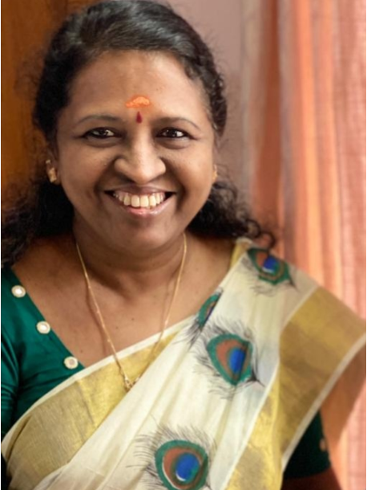
Dr. SHEEJA K P
HOD
Dept. of Archetecture

Slide 43
Dr. SHEEJA K P
HOD
Dept. of Architecture
Joined CET in 1994
Worked at GEC Wayanad , RIT Kottayam and CET
27 Years of service with Teaching , Research and Administration
Curriculum committee Chairman of University of Kerala, MG University and KTU
An excellent singer also
Husband, Dr Shaji V R (Retired Conservation officer)
Daughters, Er. Archa S and Er. Anjana S
Retired on 30/04/2021
Notes:
‹#›

Slide 44
DEPARTMENT OF MATHEMATICS

Slide 45
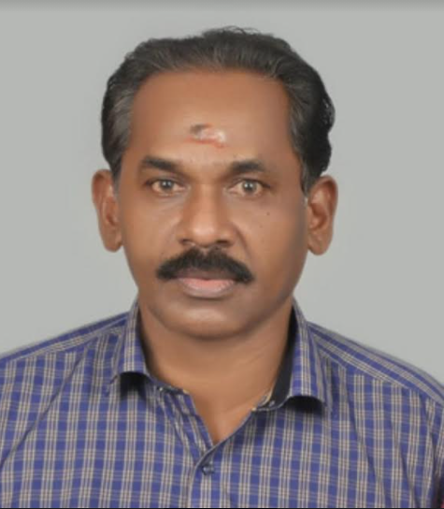
PROF. GANESH N
(Department of Mathematics)

Slide 46
PROF. GANESH N
(Department of Mathematics)
Awarded with Good Service Entry by Government of Kerala.
Worked at District and State Planning Board
Worked at CET, Govt Polytechnic, Kottayam, MTI, Thrissur and University College.
An excellent teacher of Mathematics . His video lectures in Youtube is really helping many students
Wife – Sreeja S
Daughters – Dr. Geethu G S, Greeshma G S

Slide 47
TECHNICAL STAFF

Slide 48
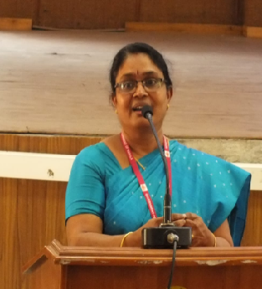
Smt. MAYA S. S
(Workshop Instructor, Civil and Mechanical Departments)

Slide 49
Smt. MAYA S. S
(Workshop Instructor, Civil and Mechanical Departments)
Joined CET in 2000
Worked at Govt. Polytechnic Vennikulam , CET (Mechanical and Civil Departments), and Govt Model high School Thycad
An excellent demonstrator of experiments
Qualified with B.Sc (Physics) and B.Tech
Husband – Bose B (Retired Additional Law secretary)
Son – Yedu Bose (Social Media Manager)
Daughter – Yamini bose ( Business Analyst )
Retired on 31/05/2021

Slide 50
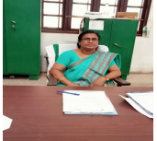
Smt.REMA S
(Workshop Instructor, Civil Department)

Slide 51
Smt. REMA S
(Workshop Instructor, Civil Department)
20 Years of Experience in Various Civil Engineering Labs,14 Years of Working Experience in CET
Worked at CET , Technical High School Kulathoor, Govt Polytechnic Wayanad and Govt Polytechnic Kottayam
Had given technical support to many students projects
Daughters – Arya S R and Aiswarya S R
Retired on 30/04/2021

Slide 52
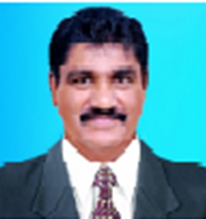
Sri. CHRISTOPHER J
(Department of Civil Engineering)

Slide 53
Sri. CHRISTOPHER J
(Department of Civil Engineering)
Ø
25 years in different post in Government service
Joined CET AS Trade Instructor Grade -1
Worked as QA/QC inspector
8.5 years of experience as QC inspector in various projects at Dubai and UK
Aramco approved QC Inspector ( K.S.A)
Wife - Bindhu Christopher
Sons - Cibin C. Araden and Christiano C Araden (students)
Daughter - Christeena C Araden( Student)
Retired from CET on 31/05/2021

Slide 54
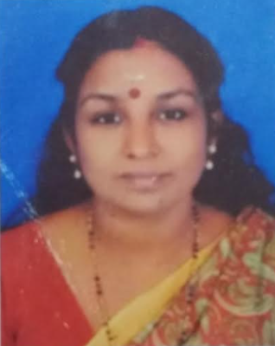
Smt. JALAJA
Dept. of Electronics and Communication Engineering

Slide 55
Smt. JALAJA
Dept. of Electronics and Communication Engineering
20 years in Technical Education.
Worked at CET for 7 years
Qualified with B. Tech
Husband – D. Baiju (Rubber Board)
Son - Agile B Dinak (Mechanical Engineer, Dubai)
Daughter – VidhyaLakshmi( MBBS student)
Retired on 30/04/2021.

Slide 56
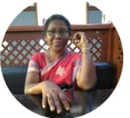
Smt. VALASALA C
(Dept. Electronics and Communication Engineering)

Slide 57
Smt. VALASALA C
(Dept. Electronics and Communication Engineering)
Qualified with Diploma in Electronics Engineering
21 years of experience as trade instructor at WPT Kaimanam, PT Punalur, RIT Kottayam and CET
Husband , Wilson T.M (Working in private sector)
Son - Vipin Wilson (Student)
Native place - Kollam

Slide 58
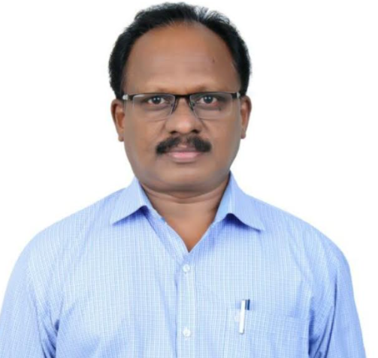
Sri. SURESH KUMAR G
(First Grade Instructor in Mechanical Engineering )

Slide 59
Sri.SURESH KUMAR G
(First Grade Instructor in Mechanical Engineering)
21 years of technical experience
Worked at Thrissur Technical High School, Pambadi Technical High School and CET
Have given technical support to many R&D projects
Wife- Geetha Devi (Secretariat Assistant)
Daughter - Student
Retired - 31/05/2021

Slide 60
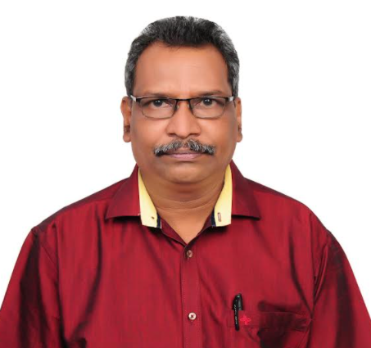
Sri. MONI S
(Trade Instructor in Mechanical Engineering)

Slide 61
Sri. MONI S
(Dept. of Mechanical Engineering)
Joined in Government service on 24/8/1995
Worked at Technical school Kulathupuzha, Technical High school,-Vannappuram, Government Polytechnic- Shornur,
Women’s Polytechnic Kaimanam, Meenangadi Polytechnic-Wayanad and CET
An excellent demonstrator of experiments
Wife - Latha K. C. (Music Teacher)
Son - Akhilesh Moni (Student)
Retired on 31/05/2021

Slide 62
ADMINISTRATIVE SECTION

Slide 63
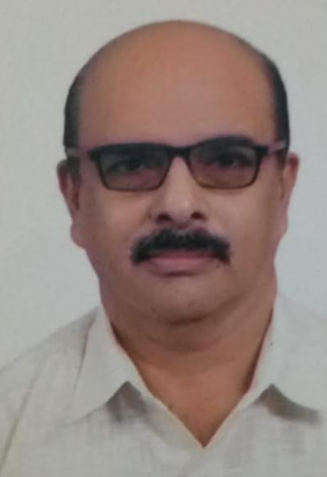
Sri. SAJEEV .H
(Accounts Officer)

Slide 64
SAJEEV .H
(Accounts Officer)
Date of Joining in service - 25/07/1989
Qualified with B.Sc, MA and Departmental Accounts Tests
32 years of Administrative service
Handled the management of all kinds of Accounts, Cash book and Audit replies
Wife - Viji J (Teacher)
Children - Two sons and one daughter
Retired on 31-05-2021

Slide 65
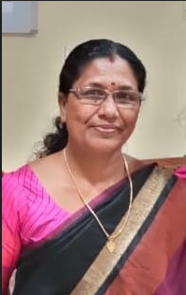
Smt. VINITHA KUMARI E.V
(Fair Copy Superintendent)

Slide 66
Smt. VINITHA KUMARI E.V
(Fair Copy Superintendent Main Office)
Date of Joining in CET - 22/04/2015
Work Experience - 32 Years
Expert in Malayalam and English document preparations
Husband - Keerthi Kumar (Retired sub Inspector)
Sons - Arjun (Regional Manager- Pharma Company)
- Vishnu (Senior Software Developer)
Retired - 31/01/2021

Slide 67
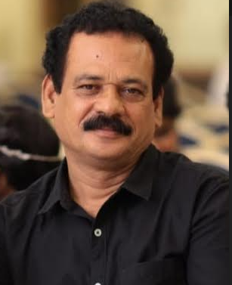
Sri .MOHAMMED RASHEED
(Staff of Administrative office)

Slide 68
Sri .MOHAMMED RASHEED
CLERK (Administrative office)
Handled documents in various administrative sections in CET
Joined in CET on 2012
Family- wife and two daughters
Retired Date - 30/04/2021

Slide 69
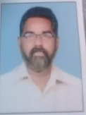
Sri.SURESH BABU R
Staff- Administrative office

Slide 70
Sri.SURESH BABU R
Staff - Administrative office
Date of Joining- 07/07/2003
Qualification- B.Com
Assisted all the sections in CET administrative office
Wife - Sindhu D (Teacher)
Daughter - Devika Suresh (MBBS )
Son - Dev S S (B A History)
Retired - 3/04/2021

Slide 71
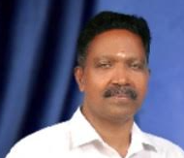
Sri. RAVEENDRAN P
(Staff- Administrative office)

Slide 72
Sri.RAVEENDRAN P
(Staff- Administrative office)
Joined in service -14 January 2001
21 years of Govt. Service
Assisted all the sections in CET administrative office
Worked at Govt Engineering College Palakkad and CET
Wife and Two Daughters - Athira (Hotel Management)
- Anupama (Student)
Retired on - 30/04/2021

Slide 73
Thank you all…
Notes:
‹#›

